Slide 1



Security Patterns for Dataverse Data in Power BI
Scott Sewell Principal Program Manager Microsoft Power BI CAT
Notes:
Understanding how to manage securing data from Dataverse into Power BI is important for a proper design. There are three significant approaches to be considered based on the use case for any given report. Within an organization any combination of these – or only a single approach may be used across the variety of reports deployed.
The video includes references to a number of important and relevant pages that should be reviewed as part of the design planning phase of any implementation.
Overview of Dataverse / Power Platform Modeling for Power BI: https://learn.microsoft.com/en-us/power-bi/guidance/powerbi-modeling-guidance-for-power-platform
Report-Level Sharing: https://learn.microsoft.com/en-us/power-bi/collaborate-share/service-share-dashboards
DirectQuery Guidance (2 Docs): https://learn.microsoft.com/en-us/power-bi/connect-data/desktop-directquery-about https://learn.microsoft.com/en-us/power-bi/guidance/directquery-model-guidance
Row Level Security (RLS) Guidance (2 Docs): https://learn.microsoft.com/en-us/power-bi/enterprise/service-admin-rls https://learn.microsoft.com/en-us/power-bi/guidance/rls-guidance

Slide 2

Security implementations in Dataverse are like snowflakes…
Beautiful… as long as you’re not the one holding the shovel.

Slide 3

Security Elements in Dataverse
Business Units
Users
Teams
Access Teams
Security Roles and Settings
Tables
Fields
Activity Party
Record Owners
Team Membership
User Hierarchy settings
Sharing to Individual
Sharing to Team
Inheritance/Indirect Sharing
Reassignment Sharing
Field-Level Security

Slide 4
Diversity of Customers + Flexibility of security options = Infinite variations in practice.
Everything from “none” to unmanageable

Slide 5
Security in Dataverse-Power BI Report
Report-Level
If the user can see the report, they can see any data in it.
Can share Power BI Reports and/or Workgroups to individuals or teams.
One interesting use case is when users can’t see each other’s data in Dataverse, but once the data is aggregated into KPIs for a ‘scoreboard’ they are allowed to see those values.
Row-Level
Visibility controlled through attributes and rules in Power BI
Example would be to test logged in user against record owner, team membership, business unit, etc. but not an attempt to replicate every possible security vector.
Direct Query
Security handled entirely by Dataverse.
Data retrieved at run-time using the credentials of the logged-in report viewer.
Supports highly configured / complex partitioning of data in report for full fidelity with Dataverse.

Slide 6
Report-Level Sharing
Share Power BI reports and dashboards with coworkers and others - Power BI | Microsoft Learn
Can share workspaces or individual reports
Licensing still applies
No performance penalty
Note: this is outside of the default Dataverse-Managed workspace sharing.

Slide 7

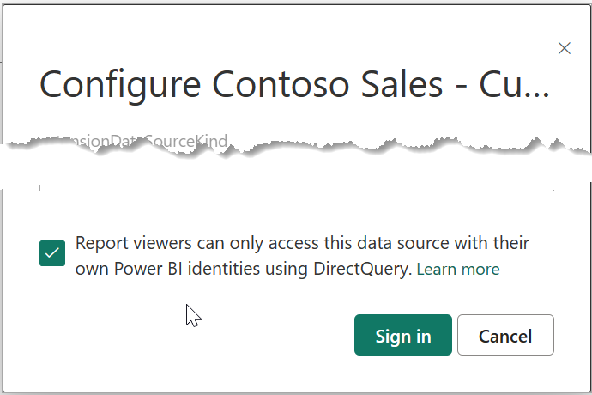
Security through Direct Query
DirectQuery in Power BI - Power BI | Microsoft Learn
DirectQuery model guidance in Power BI Desktop - Power BI
DirectQuery
DirectQuery using Dataverse Connector
Best for targeted datasets <20K rows returned
Run-time query for current data – near-real-time
Individual user’s own data (security model applies)
Data Model must be created as “DirectQuery”
Credential dialog checkbox must be set to so “Report viewers can only access this data source with their own Power BI identities using Direct Query”
Use ‘Dual’ mode for non-secured dimensions performance
Setting Dataset “Credentials”:

Slide 8
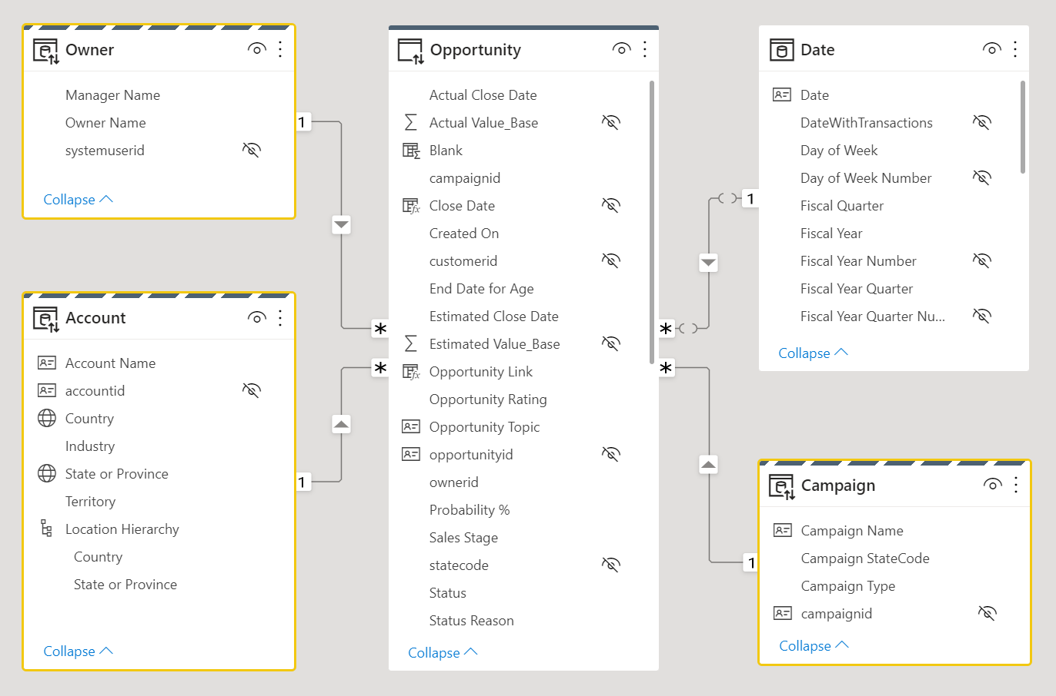
Direct Query Example
Consider the following data model design:
The Fact table, Opportunity, which typically store large volumes of data, should remain as DirectQuery storage mode tables.
It is filtered by the related dual storage mode dimension tables, Owner, Account, and Campaign joined to the fact table to achieve efficient filtering and grouping.

Slide 9
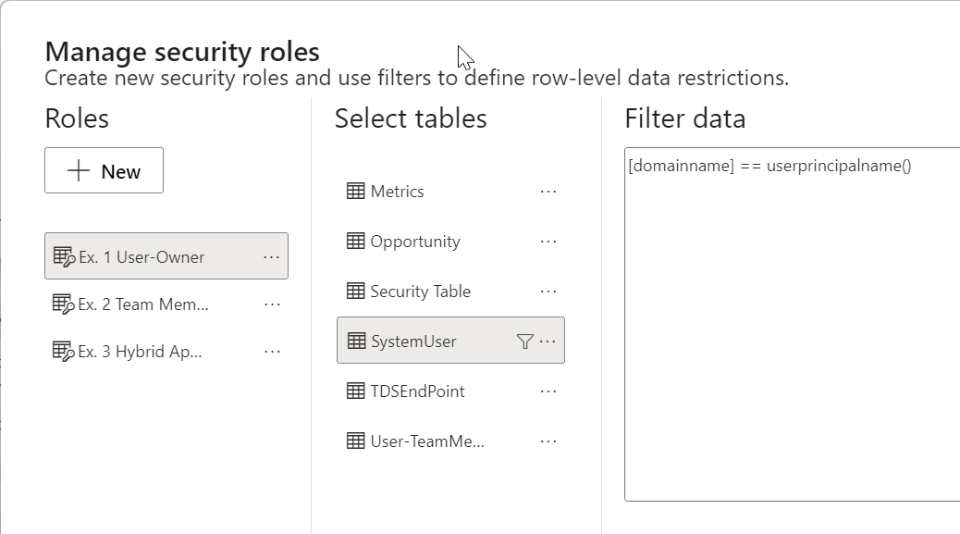
Row Level Security (RLS)
Roles are at the report/dataset level. Changes to the expected rules require updates to every report affected.
Rules can reference elements such as team membership or record ownership imported from Dataverse.
An open-ended requirement of ‘duplicating Dataverse security’ is wildly unrealistic.
Row-level security (RLS) with Power BI
Power BI Row-level security (RLS) guidance

Slide 10

RLS Demo: Dynamics Opportunities
1: User
2: User’s Team membership
3: Hybrid Security Table

Slide 11
Security in Dataverse-Power BI Report
Report-Level
Lowest Effort
Fastest Speed
Massive Datasets
“Executives”
Synapse or Dataverse Connector
Row-Level
Challenging
Complexity affects Speed
Partitioned Results
“Managers/Teams”
Synapse or Dataverse Connector
Direct Query
No Extra Maintenance
Slowest Interactivity
Individualized Data
“Front-line Workers”
Dataverse Connector Only

